Slide 1
MSD Final Project
Aanchal Chobisa
Christopher Dean
Seth Esther

Slide 2
Satellite
Slow, Expensive, 2400bits/s
HUB
Fast, Cheap, 11Mbits/s
Device 1
Device 2
Device 3

Slide 3
Assumptions
Controller makes the decision about which memory unit to store the data into, which is currently available and ready to be used.
The M1 Unit of memory is used as the look up table which stores all the transaction details.
The first two byte of the incoming command goes to the controller to read the address, tag and other fields , but the commands from the consecutive signals of the same data are thrown out.
The memory and bus keeps track of every signal responses occurring using a table of memory unit M1. It manages who has access to data bus, what operations are to be performed , the control lines , etc.
The Eviction policy Used is FIFO. We assume that this eviction policy evicts lines which are 1024b in size only , using the FIFO in those bits sequence.

Slide 4
Specifications
We are using 10 memory units of M3 unit.
We are using 1 memory unit of M1 unit.
The data would first come to the buffer and then go to the memory unit.
The speed of data from the Hub to the device is 11Mb/s, while that of the satellite is 2400Mb/s.
The write Through policy applied whenever an eviction occurs.
The eviction policy considered is FIFO, i.e. First In First Out.
The Contents of a chunk of Data
The Address bits tells us the address where the data has to be stored.
Size bits tells us the size of the data coming in as whether it is 128B, 516 or 1024b data
Address Size Last Transaction

Slide 5
Eviction Policy
A First-In-First-Out cache is one that uses queuing logic for its backing store, expunging the elements at the front of the queue when a predetermined threshold is exceeded.
It is simple to implement and understand. Because the policy requires very little information, the implementation is reasonably efficient.
Notes:
Its logic is easy to understand
It's reasonably fast
It's reasonably lightweight
Even a naive cache eviction policy may prove better than none
Your expensive calculations tend toward single-use
It works well for data subject to sequentiality

Slide 6
Memory organization
Memory 1
Memory 2
.
.
.
.
.
.
.
Memory10
1
2
3
.
.
.
1
2
3
.
.
.
.
1
2
3
.
.
.

Slide 7
Components of a memory
1
2
3
.
.
.
.
.
.
.
32
Start Tag= {Address in M3 unit, Size}
80 bits to keep a track of the free memory{0,0,0,1……..}

Slide 8
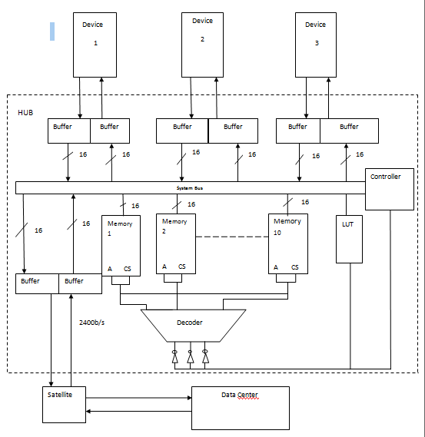
5.5Mb/s
Block diagram of the Wireless HUB

Slide 9
Result
The total Unit cost
1 X M1 unit = 1 X $50
= $50
10 X M3 unit = 10 X $3
= $ 30
The Total unit cost= $80

Slide 10
Result
The Total Latency
Traffic File 1 : 6.86E+9
Traffic File 2 : 2.02E+6
Traffic File 3 : 2.81E+10

Slide 11
Result
The total cost of Communication
Traffic File 1 : $ 0.46
Traffic File 2 : $ 0
Traffic File 3 : $ 0.69

Slide 12
Conclusion
Even considering the worst case scenario that all three devices want to communicate with the hub simultaneously by either requesting data or sending it, the system transfer times in dealing with the incoming or outgoing data are quite quick. Due to the low bandwidth of the individual device, the satellite hub has ample time to perform internal transfer operations in parallel with the communication with either the three devices connected to it, or with the satellite connected to the data center. With regard to latency, the transfer times within the data hub become inconsequential in comparison to the latencies experienced with either the devices or the satellite hub. With this in mind, the system was designed to minimize any communication with the satellite.

